Slide 1
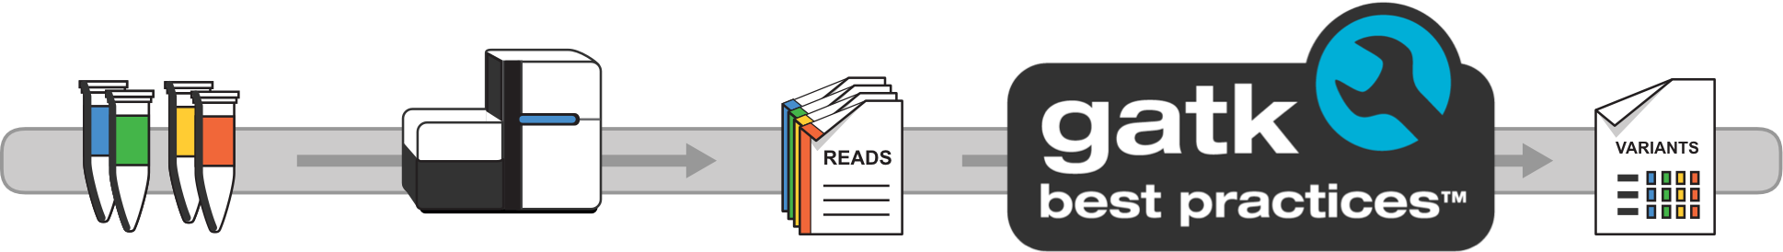
Introduction to Variant Discovery
Basic concepts, variant types and respective workflows
Presenter: Duc-Minh Nguyen-Le, MD
https://gatk.broadinstitute.org/hc/en-us

Slide 2
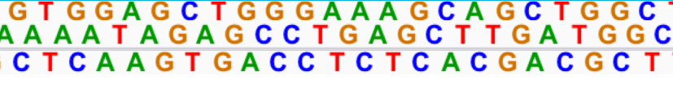
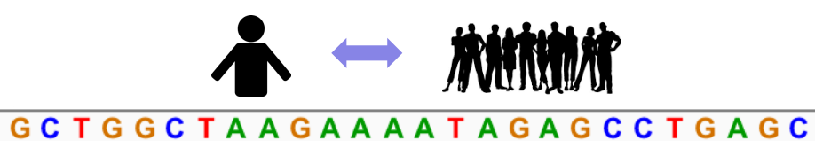
Human genomic variation
3 billions sites in the human genome
Human shares 99.5% DNA with any other human
Variant sites are commonly shared among human and most of these are biallelic

Slide 3
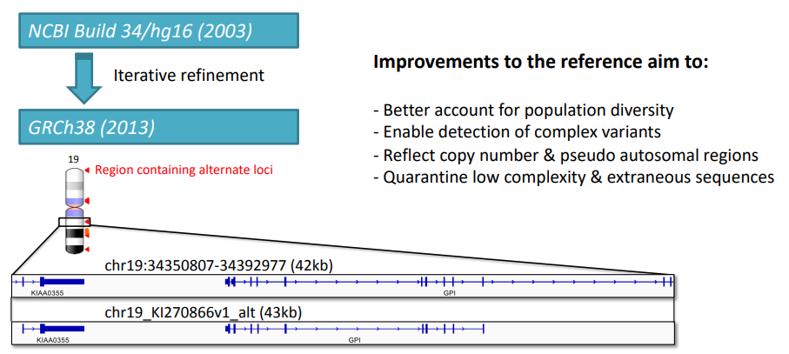
Human genome reference build GRCh38
http://www.ncbi.nlm.nih.gov/projects/genome/assembly/grc/human/

Slide 4
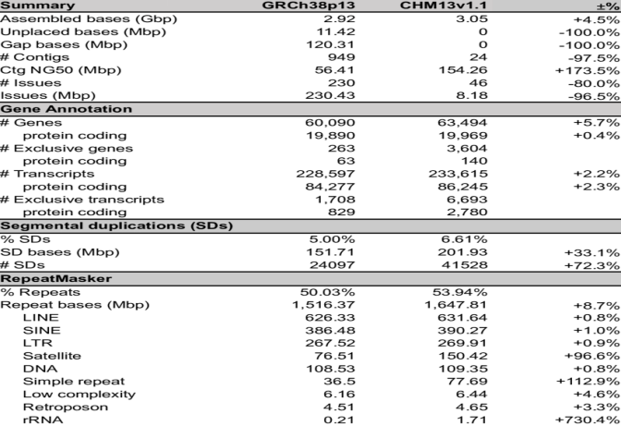

Slide 5
What is variant calling ?
Identification of probable variants in an alignment.
Four main types of variants:
Single nucleotide polymorphisms(SNPs) / Short indels
Copy number variations
Structural variants
Microsatellite Instability
2 main types of variant classifications:
Germline variants
Somatic variants

Slide 6
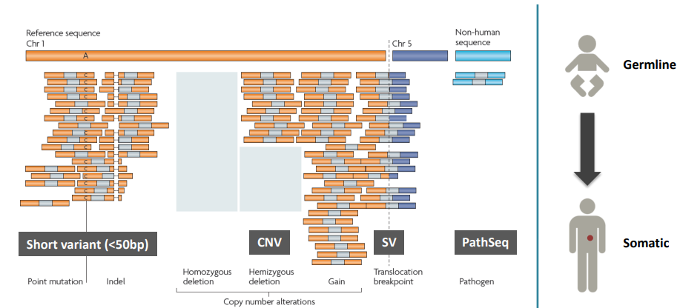
Different types of genomic variants

Slide 7
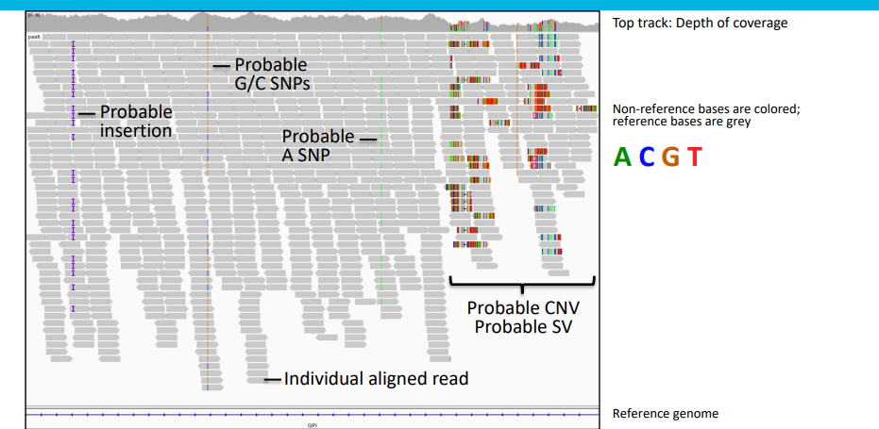
What variants look like in a genome browser

Slide 8
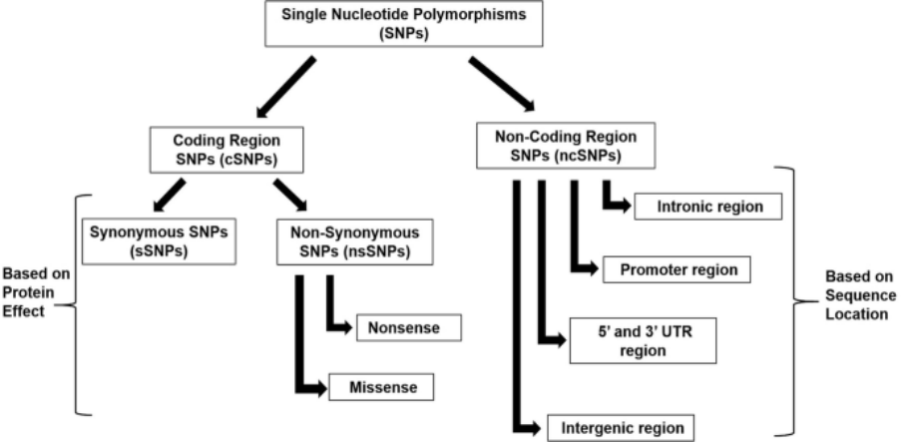
SNPs classifications

Slide 9
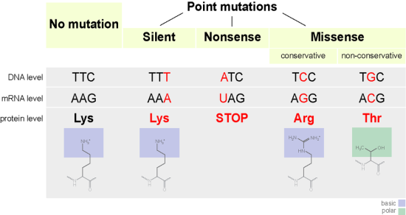
SNP/SNV
https://www.differencebetween.com/what-is-the-difference-between-point-mutations-and-indels/

Slide 10
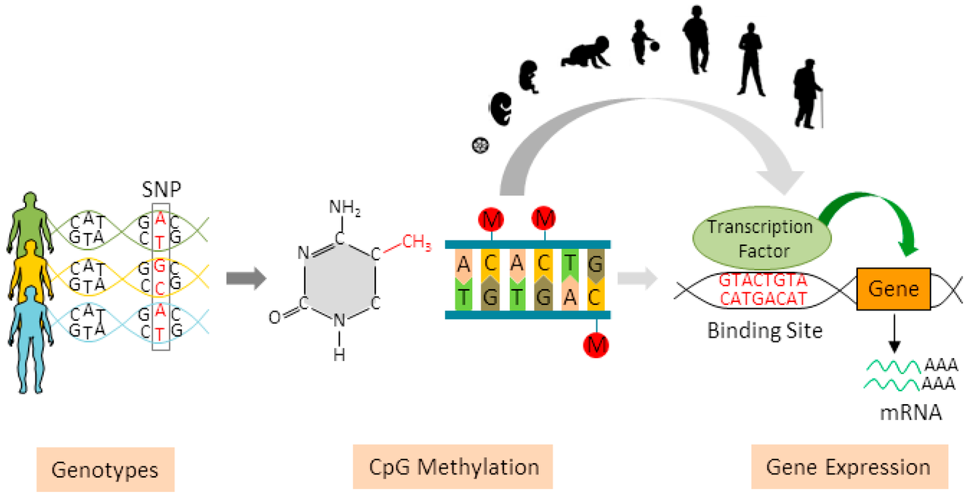
Associations between SNPs, methylation patterns and gene expression of biological traits
https://en.wikipedia.org/wiki/Single-nucleotide_polymorphism

Slide 11
Variant calling tools
 | Germline | Somatic
SNPs/Indels | Haplotypecaller, FreeBayes, Strelka, DeepVariant, mpileup | Mutect2, FreeBayes, Strelka
CNV | CNVKit | ASCAT, CNVKit, Control-FREEC
Structural variants | Manta, TIDDIT
Microsatellite Instability | NA | MSIsensorpro

Slide 12
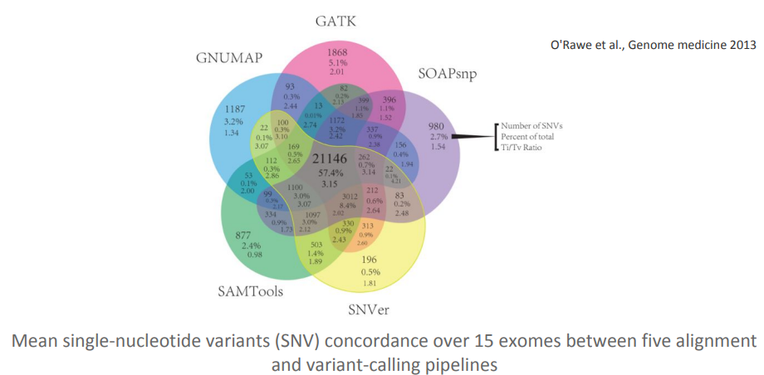
Variant callers are not concordant

Slide 13
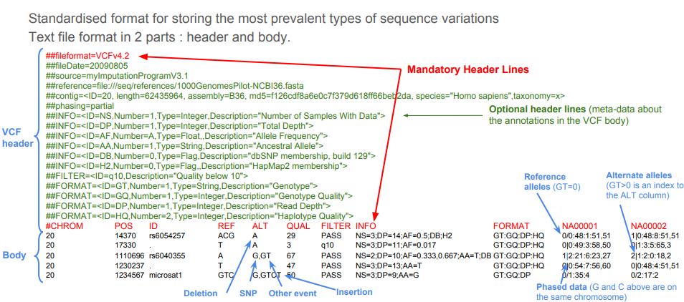
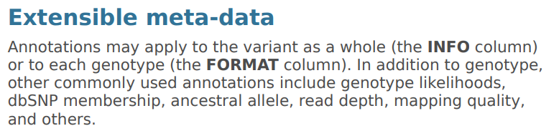
Variants are reported in VCF (Variant Call Format)

Slide 14
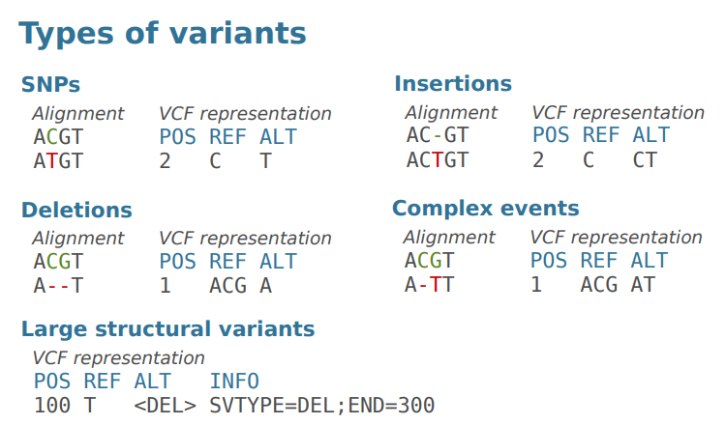
VCF: Variant Call Format (2)
http://vcftools.sourceforge.net/VCF-poster.pdf

Slide 15
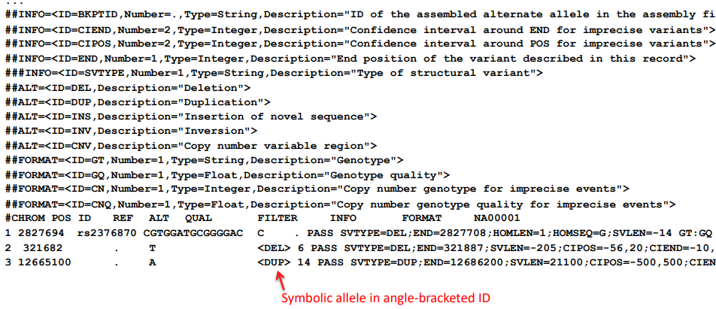
VCF format supports CNVs and SVs
https://samtools.github.io/hts-specs/VCFv4.2.pdf

Slide 16

VCF header
Lines that start with #
Some mandatory lines : file format, column header.
Optional header lines contain meta-data about annotations in the vcf body
Meta-data may vary a lot from a variant caller to another one!
INFO versus FORMAT :
INFO = annotations on variant as a whole
FORMAT = annotations that apply to each genotype

Slide 17
VCF representation of genotypes
Zygosity | VCF presentation
Heterozygous | 0/1, 1/2, 0/2, ...
Homozygous Reference Alternate | 0/0 1/1, 2/2, 3/3, …
Missing | ./0, ./1, ./., …

Slide 18
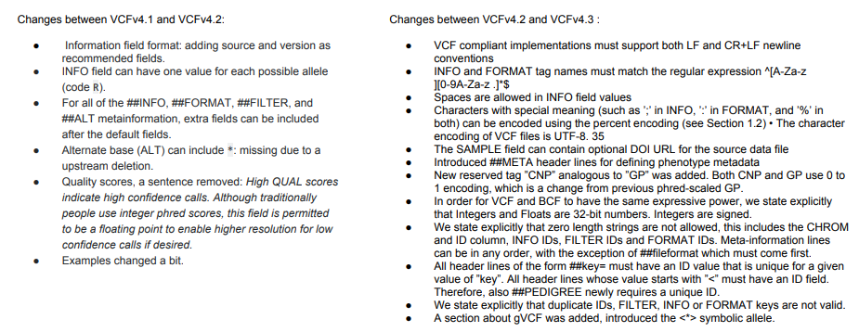
VCF specification versions

Slide 19
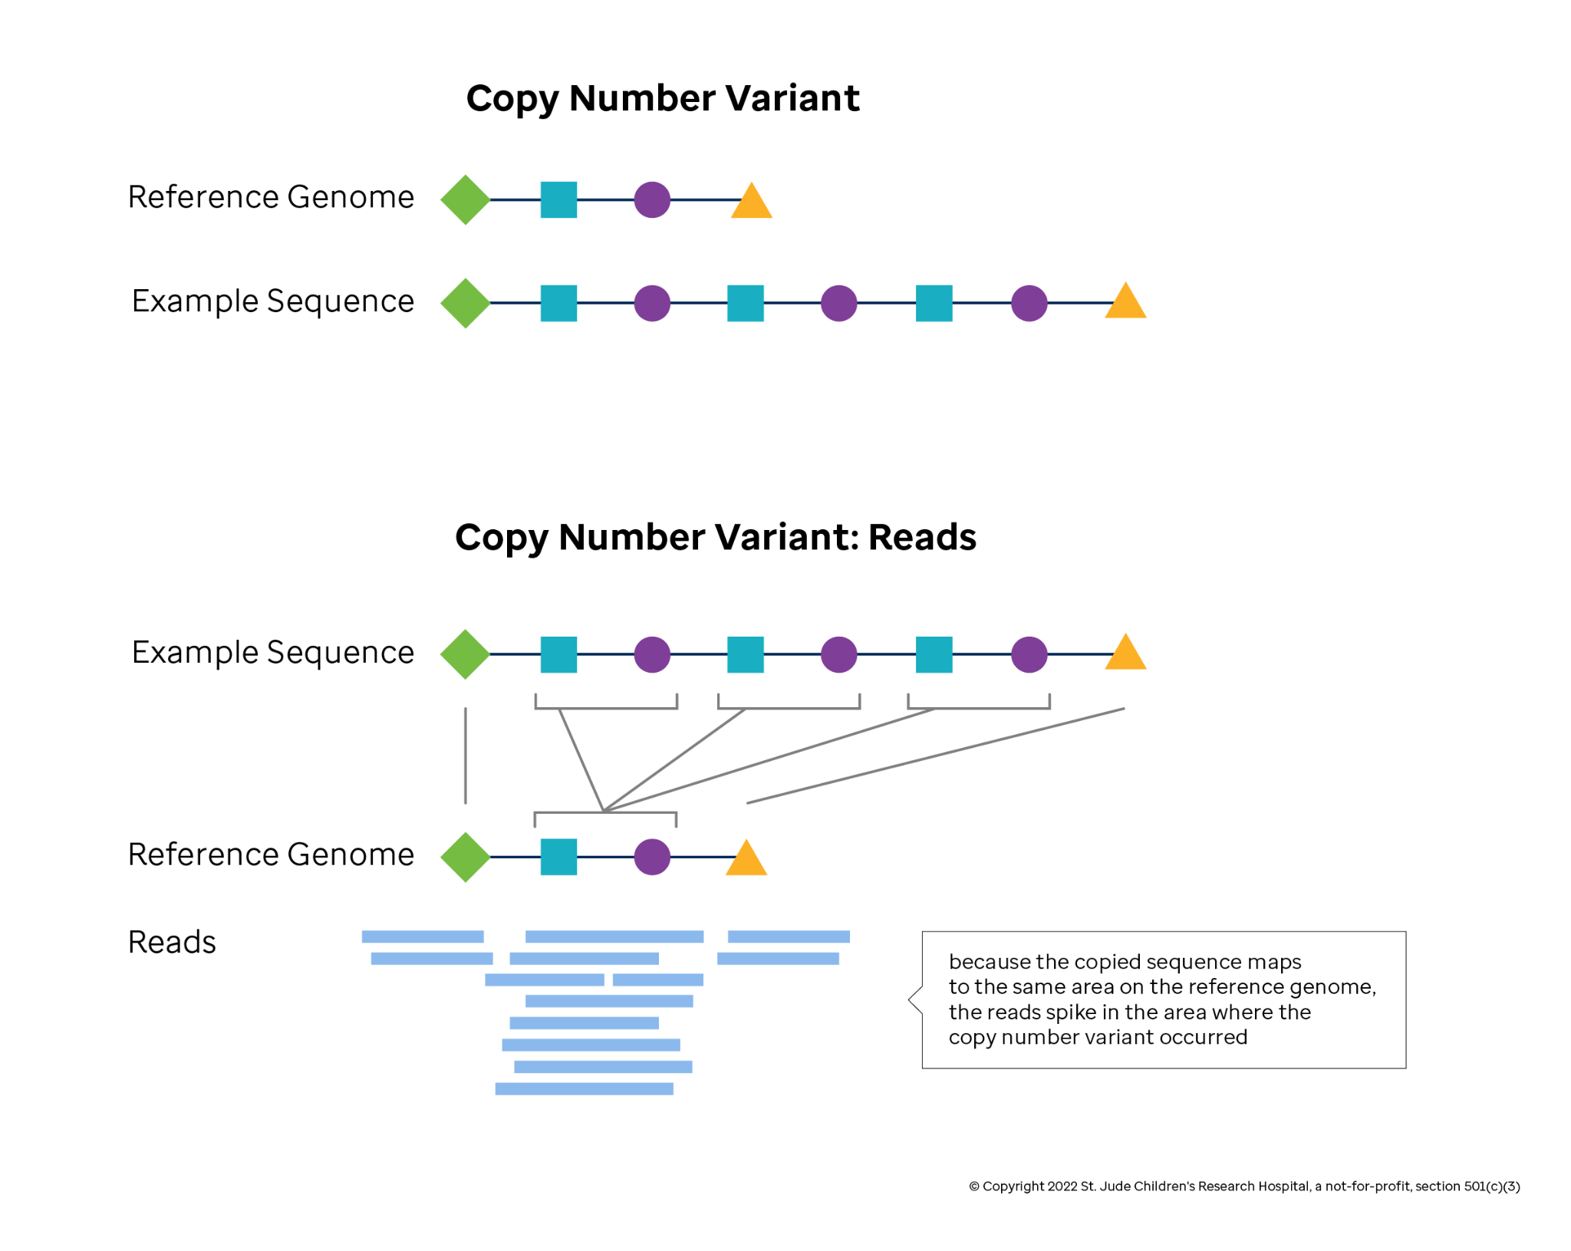
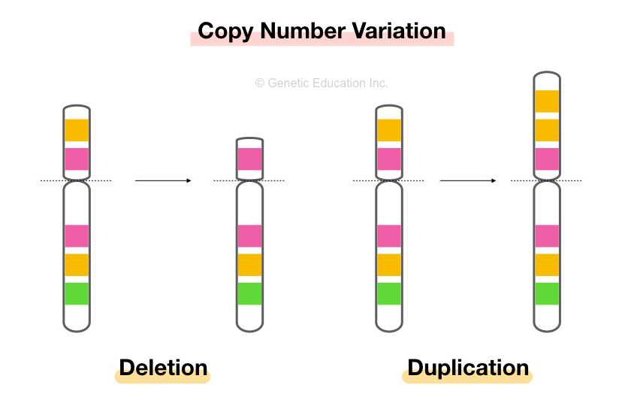
Copy number variations (CNV)
https://learngenomics.dev/docs/genomic-variation/copy-number-variation/

Slide 20
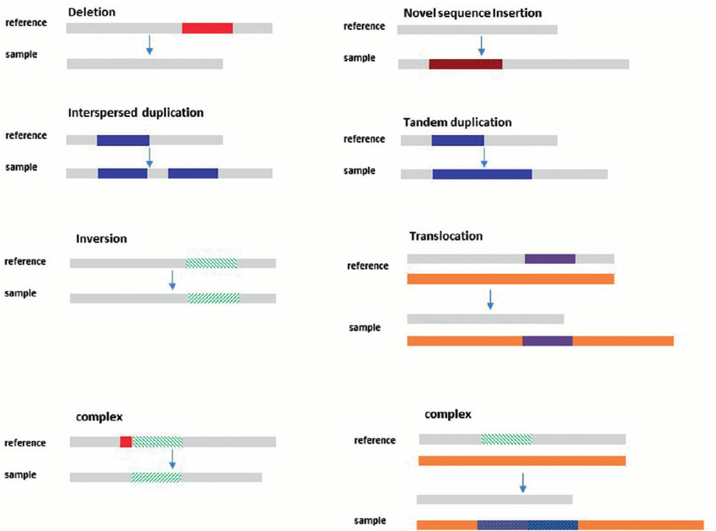
Structural variants

Slide 21
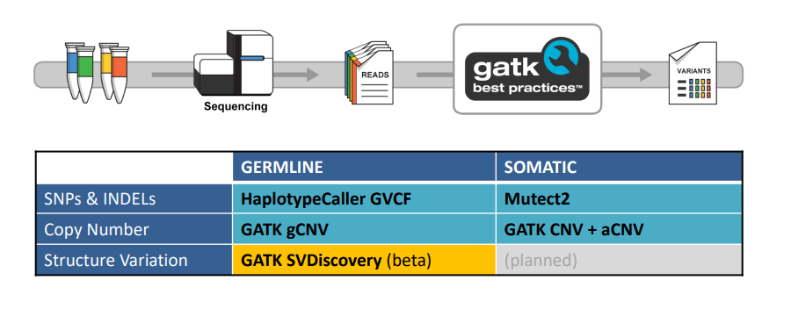
Workflows for all major variant classes
https://software.broadinstitute.org/gatk/best-practices

Slide 22
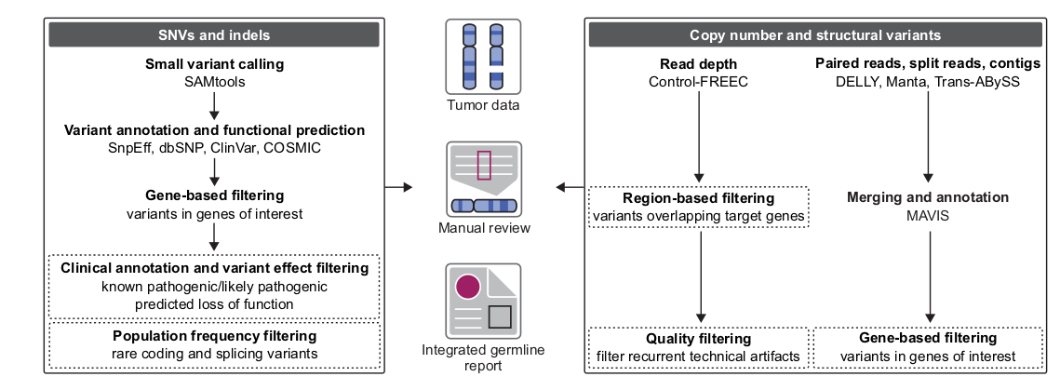
Workflow from variant calling to integrated report

Slide 23
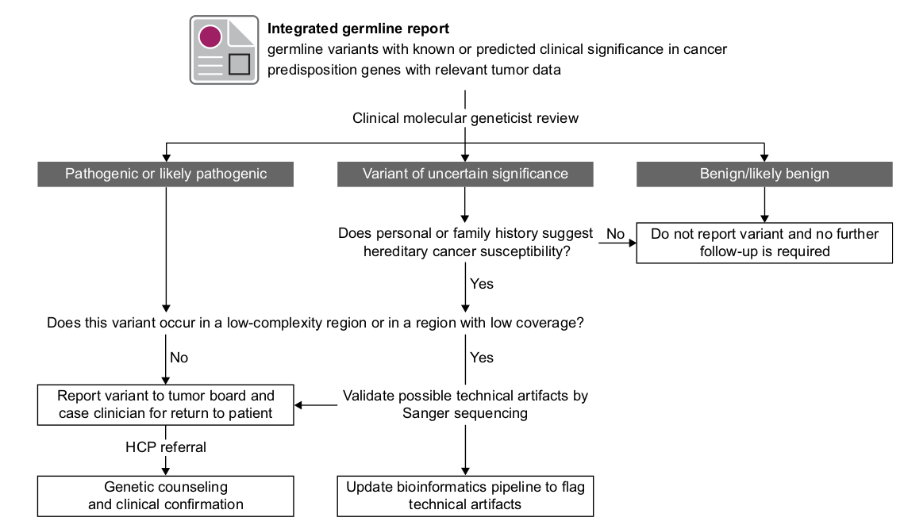
Standard procedure for the review, reporting, and clinical translation of germline variants

Slide 24
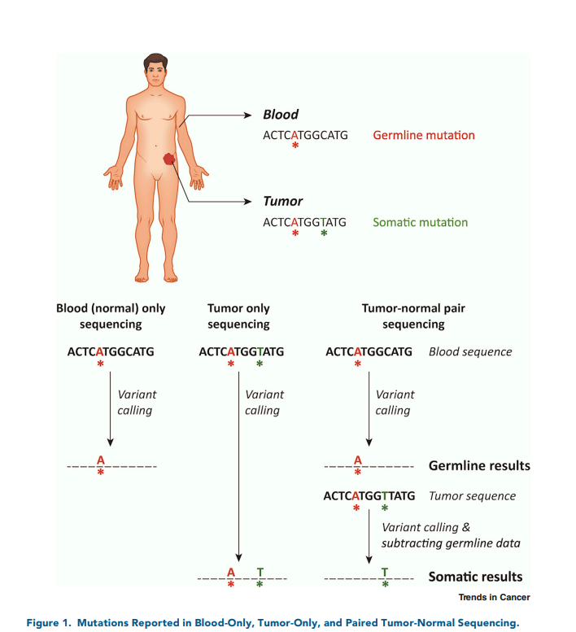
Normal - Tumor paired variants calling

Slide 25
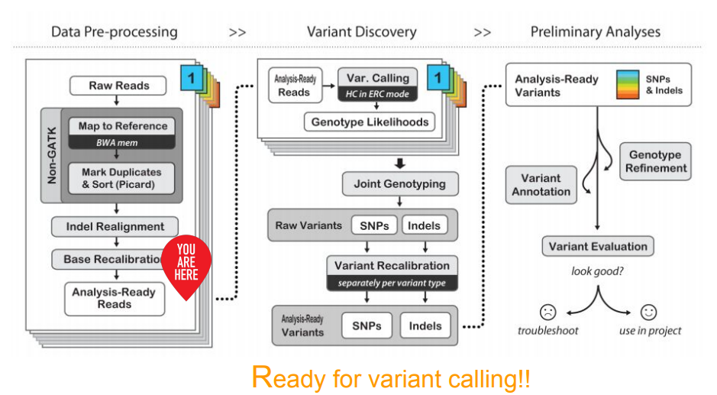
Workflow continues

Slide 26
GERMLINE SNPs & INDELs
http://software.broadinstitute.org/gatk/

Slide 27
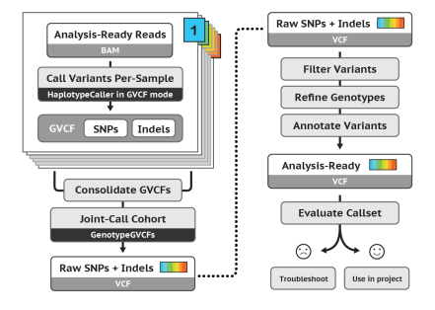
Main steps for Germline Cohort Data

Slide 28
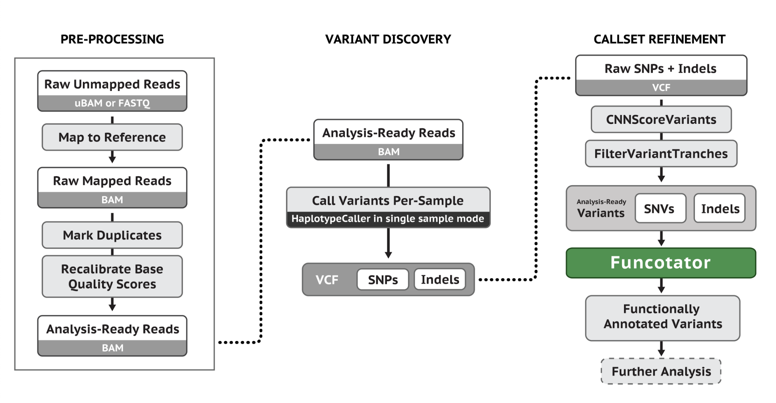
Main steps for Germline Single-Sample Data
Notes:
Single sample variant discovery uses HaplotypeCaller in its default single-sample mode to call variants in an analysis-ready BAM file. The VCF that HaplotypeCaller emits errs on the side of sensitivity, so some filtering is often desired. To filter variants first run the CNNScoreVariants tool. This tool annotates each variant with a score indicating the model's prediction of the quality of each variant. To apply filters based on those scores run the FIlterVariantTranches tool with SNP and INDEL sensitivity tranches appropriate for your task.

Slide 29
Basic operation and algorithm
Variant calling with HaplotypeCaller
http://software.broadinstitute.org/gatk/

Slide 30
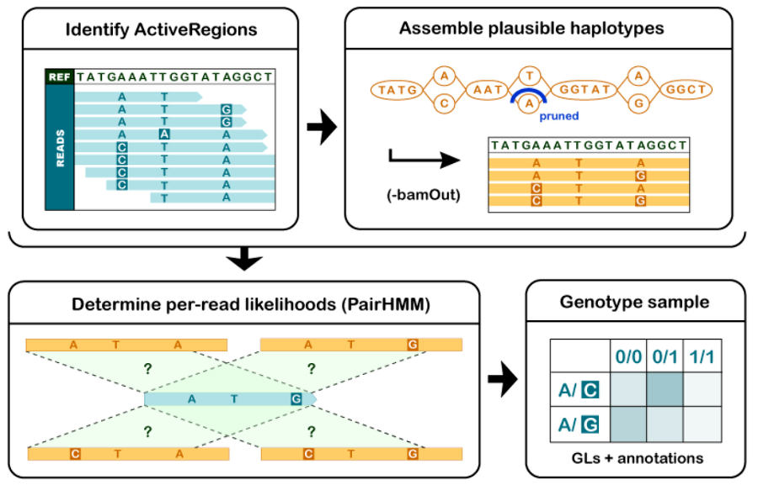
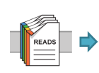
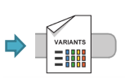
GATK HaplotypeCaller calls germline short variants
Notes:
HaplotypeCaller has high sensitivity, identify mismatches ( all reads, or some reads).

Slide 31
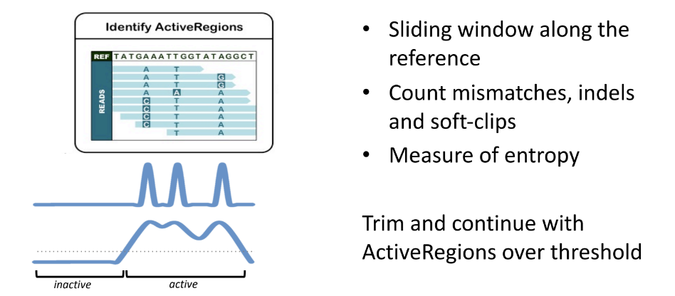
1. Define Active Regions
Notes:
Sliding window, certain length of sequence, recording how many mismatches, indels and soft-clips, identify peak regions.
Soft-clip alignment: some sites can not be reattached to the reference genome( truth difference from the seq), so after this point ignores the rest of the sequence.

Slide 32
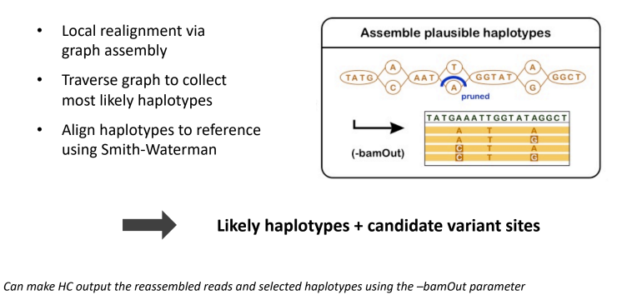
2. Assemble plausible haplotypes

Slide 33
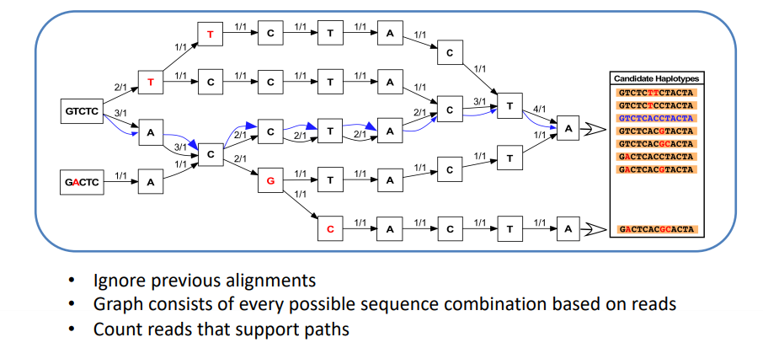
Example HaplotypeCaller assembly graph
Notes:
Idea of the assembly graph: take each read in a row and add it to the others to see what are the divergent paths. HaplotypeCaller will look at all possible paths through the graph.

Slide 34
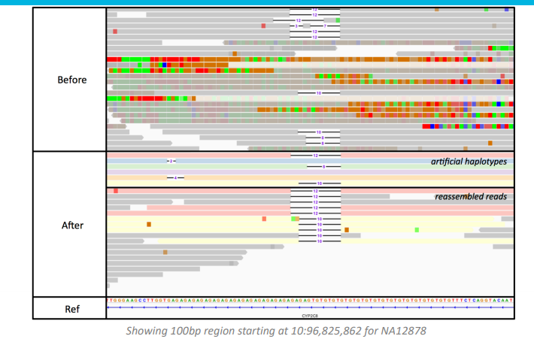
Graph assembly recovers indels and removes artifacts

Slide 35
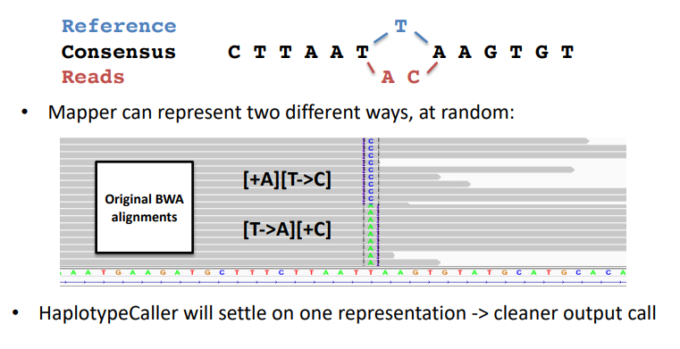
Resolves complexity caused by mapper limitations
Notes:
Ins - > Mismtach or
Mismatch -> Ins

Slide 36
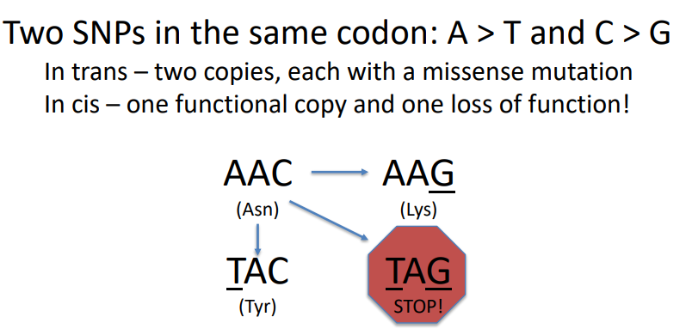
Functional implications of variant phasing

Slide 37
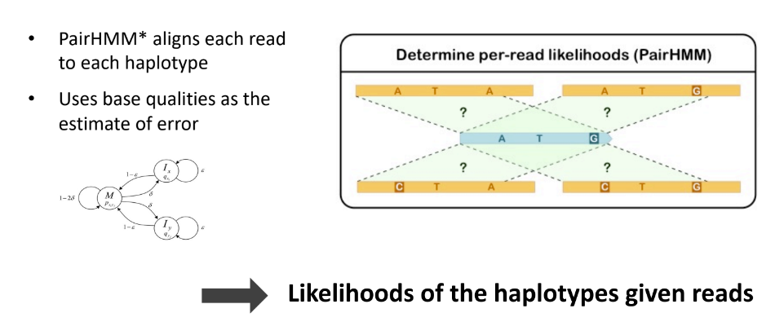
3. Score haplotypes using PairHMM

Slide 38
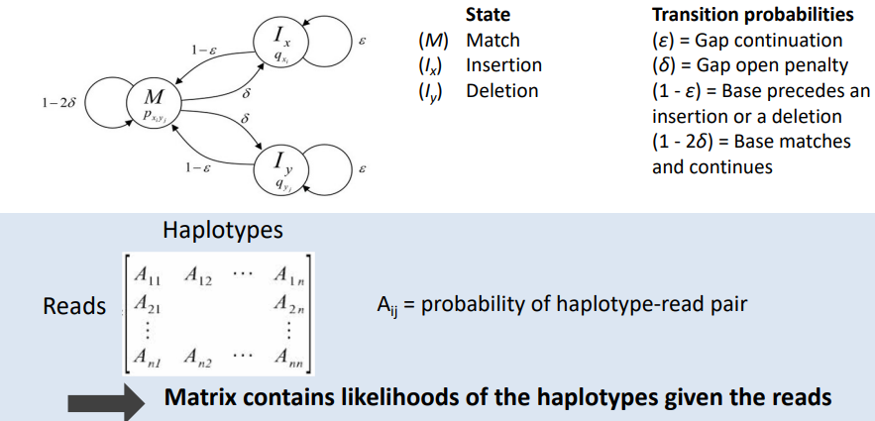
PairHMM uses base qualities to score alignments

Slide 39
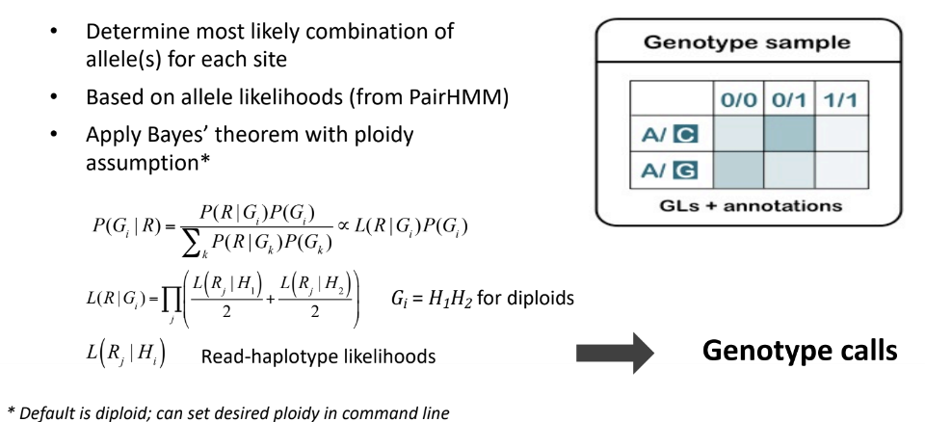
4. Genotype each sample at each potential variant site

Slide 40
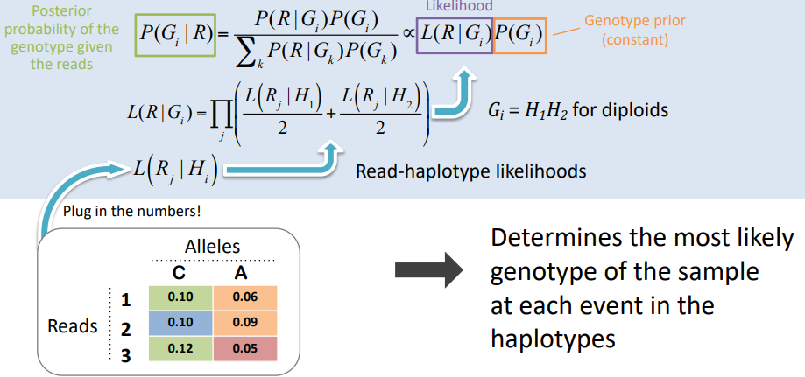
Finally, Bayesian math for genotype probability

Slide 41
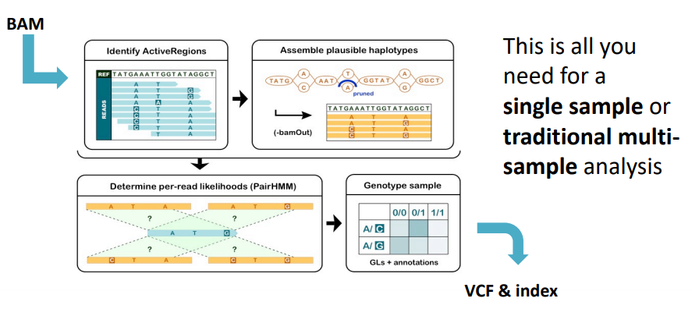
HaplotypeCaller recap: reads in / variants out

Slide 42
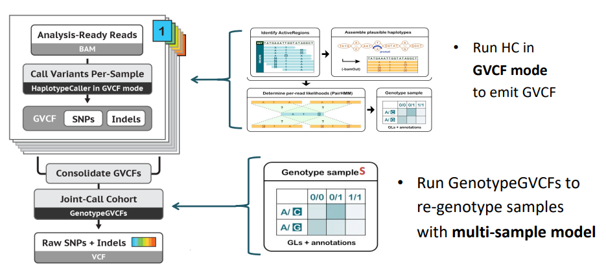
For scalable analysis: emit GVCF + add joint calling step

Slide 43
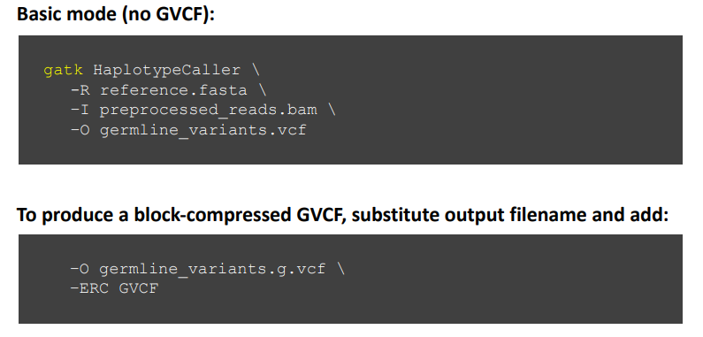
Running HaplotypeCaller
http://software.broadinstitute.org/gatk/

Slide 44
GVCF-based workflow
Joint variant calling
http://software.broadinstitute.org/gatk/

Slide 45
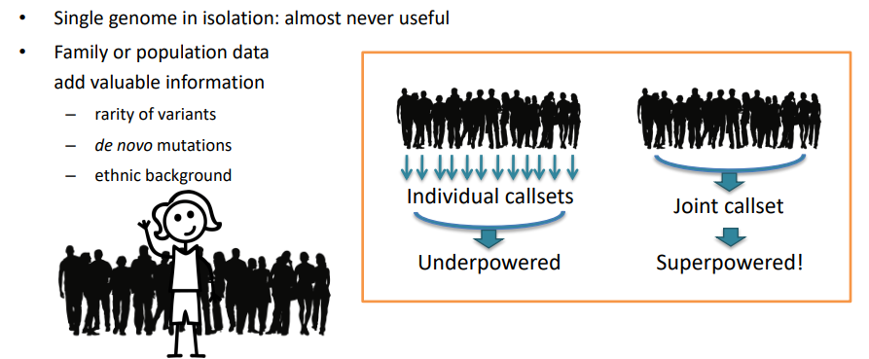
Joint analysis empowers discovery

Slide 46
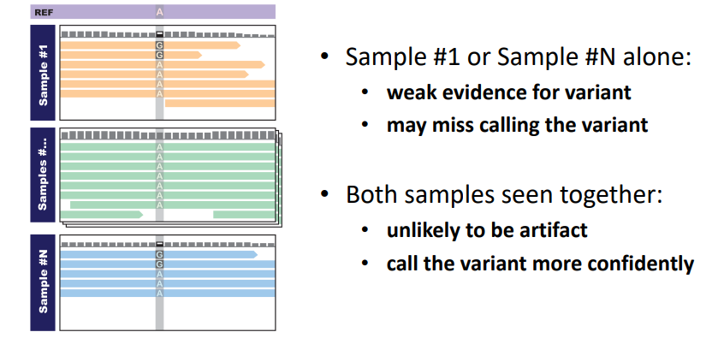
Discovery is empowered at difficult sites

Slide 47
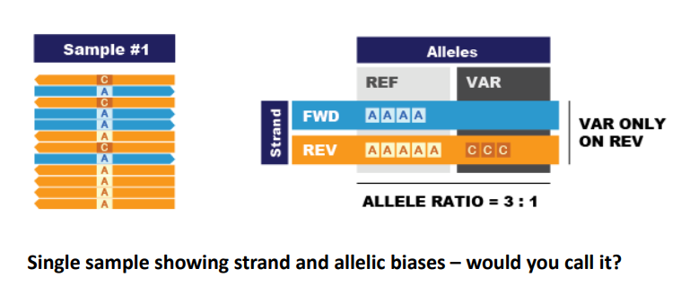
Joint analysis helps resolve bias issues (1)

Slide 48
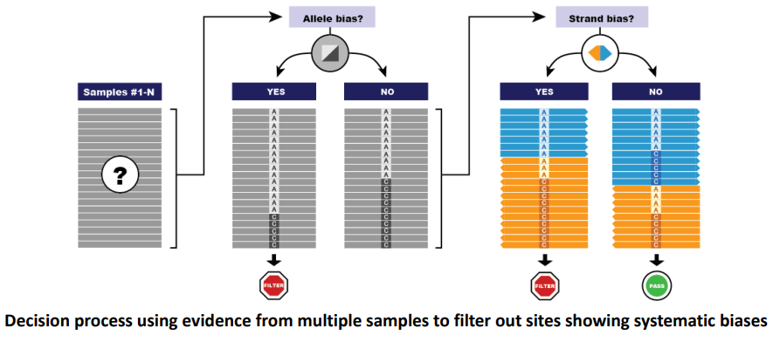
Joint analysis helps resolve bias issues (2)

Slide 49
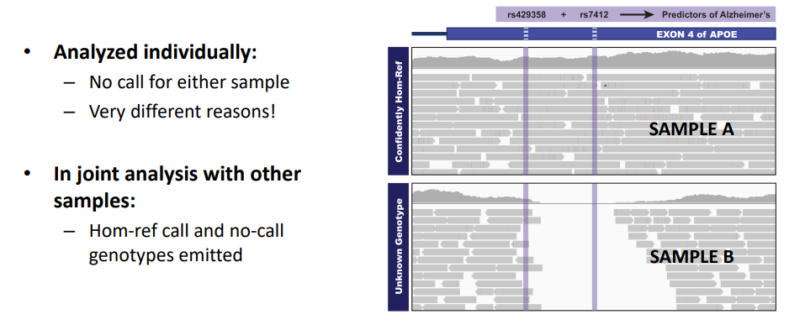
Gather full information at all sites of interest

Slide 50
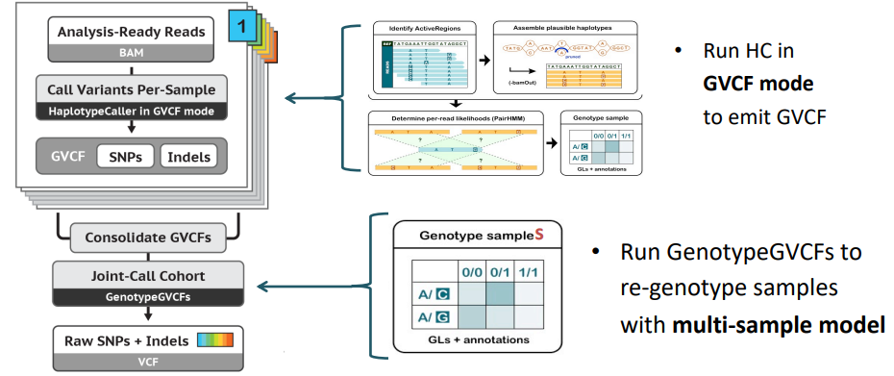
Joint calling implemented as a two-step process for scalability
http://software.broadinstitute.org/gatk/

Slide 51
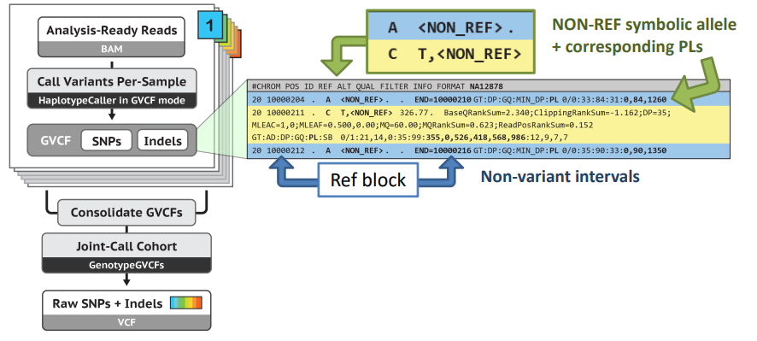
GVCF intermediate contains reference confidence estimate

Slide 52
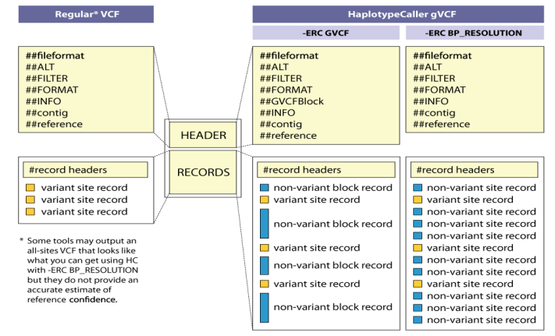
GVCFs are valid VCFs with extra information
https://gatkforums.broadinstitute.org/gatk/discussion/4017/what-is-a-gvcf-and-how-is-it-different-from-a-regular-vcf

Slide 53

Joint calling produces final multi-sample VCF

Slide 54


Consolidate GVCFs before joint calling!
Notes:
computational resources and memory
reduce errors and biases that can be introduced during variant calling
improve the sensitivity and specificity of variant calling

Slide 55


Joint calling with GenotypeGVCFs

Slide 56
Assigning accurate confidence scores to each putative mutation call
Variant Filtering
http://software.broadinstitute.org/gatk/

Slide 57

Variant Context Annotations Describe the Observed Data

Slide 58
GATK: Filtering variants
Calling algorithms are very permissive
Calling sets contain many false positives
Two filtering approaches :
○ Hard filtering : using thresholds on annotations
○ Variant recalibration using machine learning
● Sensitivity vs Specificity

Slide 59
GATK: Hard filtering
Suitable for all experiments (targeted gene, WES, small sample size, etc.)
Goal: define annotations and thresholds to filter bad variants
Pros:
Easy to perform
Cons:
Hard to define annotations to use
Hard to define threshold
May filter good variants, may keep bad variants

Slide 60
QualByDepth
The QUAL field of the VCF file is defined as a Phred score that reflects the variant quality.
The QualByDepth (QD) score is the QUAL score divided by the allele depth of the variant (i.e., the ALT allele depth).
There is no “normal” range for this value, but a QD under 2 is considered poor quality.
Notes:
bcftools query -f '%QUAL [%AD{1}]\n' raw_variants.vcf | awk '{ if($2>0) {printf "%f\n",$1/$2}}' > QD.tab

Slide 61
FisherStrand
This parameter is an estimate of strand bias, a kind of sequencing bias in which one strand is favored over the other.
The higher the value for FS, the more likely there is to be bias or false-positive calls.
Values of FS over 60 are taken to be strong evidence for strand bias.

Slide 62
RMSMappingQuality
The root mean square of the mapping quality provides an estimation of the overall mapping quality of reads supporting a variant call.
The RMS is based on the mapping qualities of the n reads that support variant call.
The threshold suggested by GATK for MQ is 40

Slide 63
MappingQualityRankSumTest
The rank sum test for mapping qualities of REF reads versus ALT reads.
Compares the mapping qualities of the reads supporting the reference allele with those supporting the alternate allele.
For variant calling, we are interested in whether there is evidence that the quality of the data supporting the alternate allele is comparatively low.
GATK suggests filtering if MQRankSum is less than –12.5.
Notes:
If there is a statistically significant difference in quality in either direction, then it suggests that sequencing and/or the mapping process may have been biased or affected by an artifact
bcftools query -f '[%MQRankSum]\n' raw_variants.vcf | awk '{if ($1<-12.5){MQRankSum++}} END {print MQRankSum}'

Slide 64
ReadPosRankSumTest
The rank sum test for relative positioning of REF versus ALT alleles within reads.
Tests whether there is evidence of bias in the genomic position of reference and alternate alleles within the reads that support them.
If a variant is called only near the ends of reads, can be an indication of error.
GATK suggests filtering if ReadPosRankSum is less than –8.

Slide 65
Strand Odds Ratio (SOR)
The strand odds ratio measures the ratio of the odds of the variant being observed on the forward strand versus the reverse strand.
A high SOR value suggests that the variant is more likely to be real, since it is observed on both strands and is less likely to be a sequencing artifact.
A low SOR value suggests that the variant may be an artifact or that there may be a bias in the sequencing or genotyping process.

Slide 66
Inbreeding Coefficient (InbreedingCoeff)
A filter option applied to indel( insertion/deletion) variants.
It is calculated based on the observed and expected number of homozygous genotypes in a population.
A positive inbreeding coefficient suggests an excess of homozygotes, indicating potential inbreeding or relatedness, while a negative coefficient suggests a deficit of homozygotes.
Variants with extreme positive or negative inbreeding coefficients may be more likely to be artifacts or sequencing errors and can be filtered out.

Slide 67
GATK: Hard filtering recommendations
Filtering SNPs where any:
QD < 2.0
MQ < 40.0
FS > 60.0
SOR > 3.0
MQRankSum < -12.5
ReadPosRankSum < -8.0
Filtering Indels where any:
QD < 2.0
ReadPosRankSum < -20.0
InbreedingCoeff¹ < -0.8
FS > 200.0
SOR > 10.0
¹ When sample size > 10
Warning: Threshold on maximum depth should not be used for WES data

Slide 68
GATK : Variant Quality Score Recalibration (VQSR)
Preferred method
Requires:
DNA-seq data ( not working on RNA-seq data)
Well curated training/truth resources (usually not available for non human organisms)
Large amount of variants (no targeted gene panels, etc.)
> 30 samples for WES data ( 1000G WES samples can be added if needed but not optimal)
Based on machine learning

Slide 69

GATK : VQSR workflow

Slide 70
GATK : VQSR SNP human resources
Hapmap
Training
Truth
Prior = 15
Omni
Training
Truth
Prior = 12
1000G SNPs High confidence
Training
Prior = 10
dbSNP
Known
Prior = 2
Annotations: QD, MD, MQRankSum, ReadPosRankSum, FS, SOR, DP¹, InbreedingCoeff
GATK (broadinstitute.org)
¹ Not to be used for WES

Slide 71
GATK : VQSR Indel human resources
Mills Indels
Training
Truth
Prior = 12
dbSNP
Known
Prior = 2
Annotations: QD, MD, MQRankSum, ReadPosRankSum, FS, SOR, DP¹, InbreedingCoeff
GATK (broadinstitute.org)
¹ Not to be used for WES

Slide 72


Convolutional Neural Net (CNN)
Annotate a VCF with scores from a Convolutional Neural Network (CNN).
The default model should not be used on VCFs with annotations from joint call-sets.
Two ways to score variants
1D Model
Variant annotations
Reference
2D Model
Variant annotations
Reference
Read information
https://gatk.broadinstitute.org/hc/en-us/articles/13832712299547-CNNScoreVariants

Slide 73


Filter Variants with FilterVariantTranches
Apply tranche filtering to VCF based on scores from an annotation in the INFO field.
Tranches are specified in percent sensitivity to the variants in the resource files.
Higher tranches = More sensitive, less precise ( lower variant scores)
Lower tranches = Less sensitive, higher precision
The default tranche filtering threshold for SNPs is 99.95 and for INDELs it is 99.4.
https://gatk.broadinstitute.org/hc/en-us/articles/13832777777179-FilterVariantTranches

Slide 74
References
Robinson, P.N., Piro, R.M., & Jager, M. (2017). Computational Exome and Genome Analysis (1st ed.). Chapman and Hall/CRC. https://doi.org/10.1201/9781315154770
https://gatk.broadinstitute.org/hc/en-us
Official Github of GATK : https://github.com/broadinstitute/gatk
Germline short variant discovery: https://gatk.broadinstitute.org/hc/en-us/articles/360035535932-Germline-short-variant-discovery-SNPs-Indels-
Somatic short variant discovery:
https://gatk.broadinstitute.org/hc/en-us/articles/360035894731-Somatic-short-variant-discovery-SNVs-Indels-

Slide 75


